Slide 1
Analysis of Algorithmic Efficiency
Textbook Section 2.1-2.2

Slide 2
Announcements
Questions on HW 1?
No Wed afternoon office hours

Slide 3
Efficiency Analysis
Relative to input size (n)
Measured in basic operations not seconds
Interested in order of growth
How did your data structures in HW 1 compare with only 100 queries?

Slide 4
Orders of Growth
What happens when you double the input size (n)?
O(1)
O(log₂n)
O(n)
O(n²)
O(n³)
O(2^{n})

Slide 5
Worst, Best and Average Case
What is efficiency of linear search?
LinearSearch(A[0…n-1], K)
i ← 0
while i < n and A[i] ≠ K do
i ← i + 1
if i < n
return i
else
return -1

Slide 6
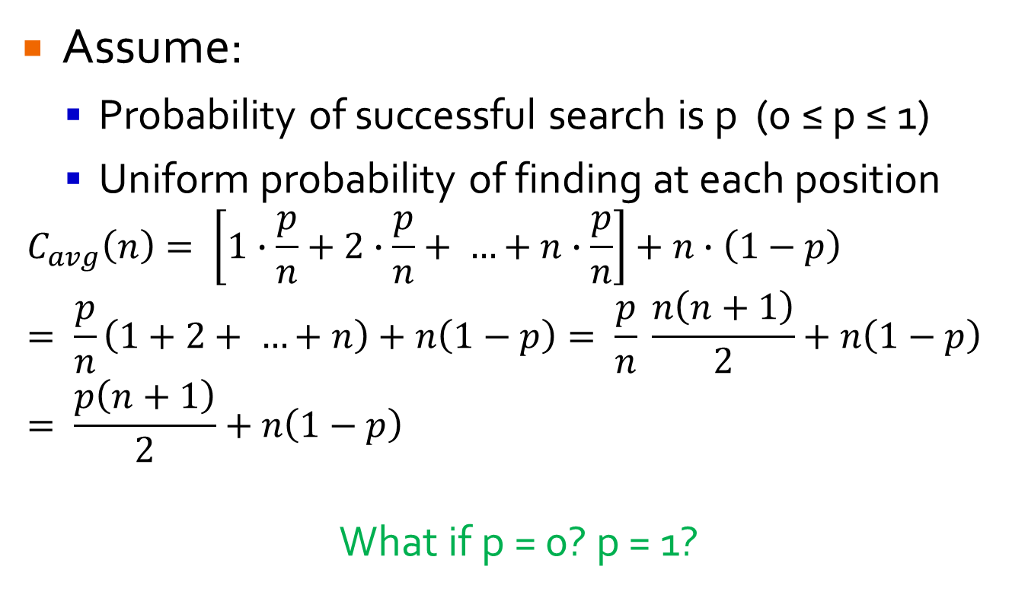
Average Case
Assume:
Probability of successful search is p (0 ≤ p ≤ 1)
Uniform probability of finding at each position
$$C_{avg}\left(n\right)= \left[1∙\frac{p}{n}+2∙\frac{p}{n}+ …+n∙\frac{p}{n}\right]+n∙\left(1−p\right)= \frac{p}{n}\left(1+2+ …+n\right)+n\left(1−p\right)= \frac{p}{n} \frac{n\left(n+1\right)}{2}+n\left(1−p\right)= \frac{p\left(n+1\right)}{2}+n\left(1−p\right)$$
What if p = 0? p = 1?

Slide 7
Worst, Best and Average Case
Worst Case: guarantees runtime will never exceed C_{worst}(n)
Best Case: if (near) best input covers useful instances, can be worth knowing C_{best}(n)
e.g. Sorting mostly sorted list
Avg. Case: hard to obtain, but important because worst case may be overly pessimistic
Amortized: single op may be expensive, but less so for each subsequent one.

Slide 8
Asymptotic Notation (Informally)
Prove runtime t(n) of an algorithm by proving bounds.
O(n) = upper bound
O(n²): all fns whose order of growth is no higher than n².
Ω(n) = lower bound
Ω(n²): all fns whose order of growth is no lower than n².
Θ(n)
e.g. Θ(n²): all fns whose order of growth is same as n².

Slide 9
Asymptotic Notation (Informally)
Which of following belong to O(n²)? Ω(n²)? Θ(n²)?
a(x) = 100n + 5
b(x) = ½ n(n-1)
c(x) = 0.00001n³
d(x) = n² + log n
e(x) = n + sin n
f(x) = 2n

Slide 10
Basic Efficiency Classes
Class | Name | Comments
1 | constant | Short of best case efficiency, very few algorithms belong to this class.
log n | logarithmic | Typically result of cutting problem size by constant factor on each iteration (Ch. 4) Doesn’t examine all/most of input.
n | linear | Algorithms that scan all of the input, e.g. linear search.
n log n | linearithmic log-linear | Many divide and conquer algorithms (Ch. 5) belong to this category, e.g. mergesort and quicksort.
n² | quadratic | Characterizes efficiency of algorithms with 2 embedded loops, e.g. simple sorting algorithms and operations on nxn matrices.
n³ | cubic | Characterizes efficiency of algorithms with 3 embedded loops, e.g. nontrivial algorithms from linear algebra.
2^{n} | exponential | Typical for algorithms that generate all subsets of n-item set.
n! | factorial | Typical for algorithms that generate all permutations of n-item set.

Slide 11
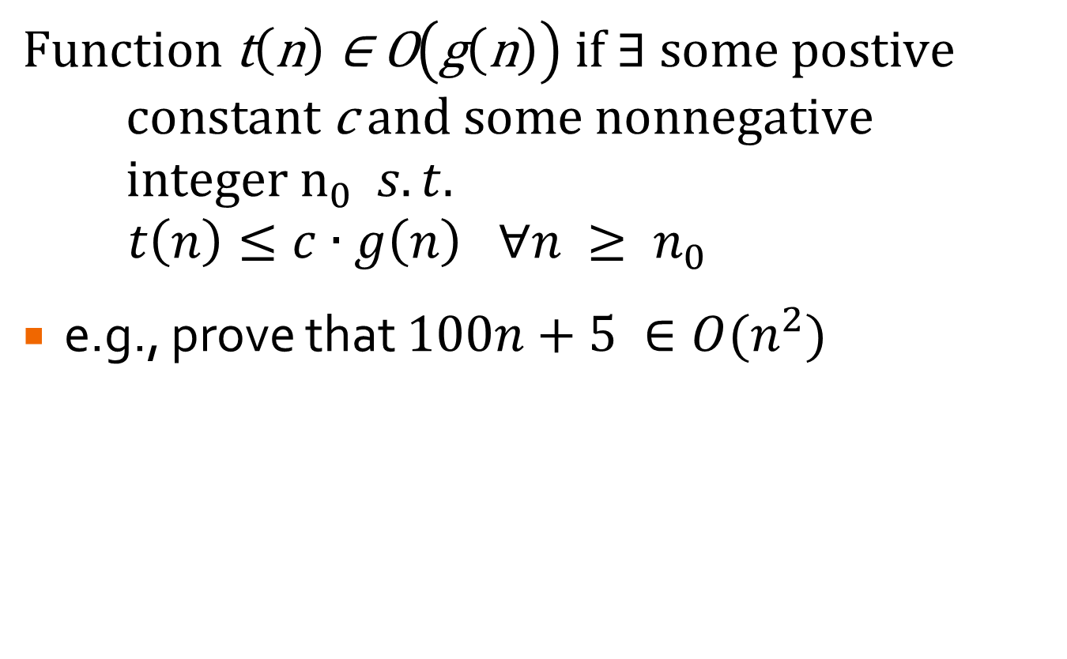
O-Notation (formal)
$$\text{Function} \text{t}\left(\text{n}\right) \text{∈ }\text{O}\left(\text{g}\left(\text{n}\right)\right) \text{if}\text{ ∃ }\text{some} \text{postive} \text{constant} \text{c} \text{and} \text{some} \text{nonnegative} \text{integer} n_{0} s.t.$$
$$t\left(n\right)≤c∙g\left(n\right) ∀n ≥ n_{0}$$
e.g., prove that $100n+5 ∈O(n^{2})$

Slide 12
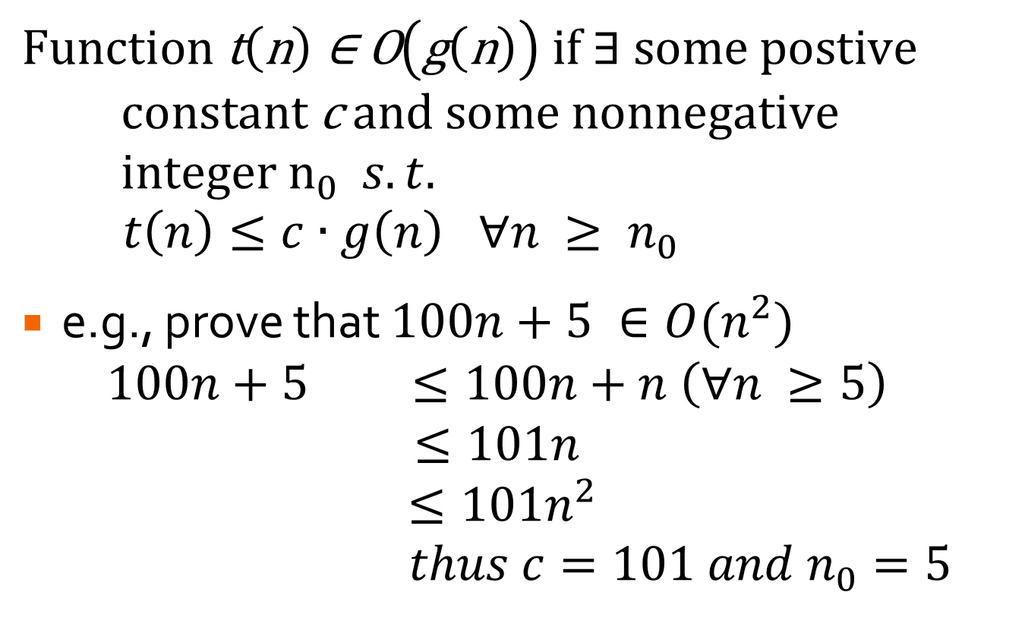
O-Notation (formal)
$$\text{Function} \text{t}\left(\text{n}\right) \text{∈ }\text{O}\left(\text{g}\left(\text{n}\right)\right) \text{if}\text{ ∃ }\text{some} \text{postive} \text{constant} \text{c} \text{and} \text{some} \text{nonnegative} \text{integer} n_{0} s.t.$$
$$t\left(n\right)≤c∙g\left(n\right) ∀n ≥ n_{0}$$
e.g., prove that $100n+5 ∈O(n^{2})$
$$100n+5 ≤100n+n \left(∀n ≥5\right)$$
$$≤101n$$
$$≤101n^{2}$$
$$thus c=101 and n_{0}=5$$

Slide 13

O-Notation (formal)
$$\text{Function} \text{t}\left(\text{n}\right) \text{∈ }\text{O}\left(\text{g}\left(\text{n}\right)\right) \text{if}\text{ ∃ }\text{some} \text{postive} \text{constant} \text{c} \text{and} \text{some} \text{nonnegative} \text{integer} n_{0} s.t.$$
$$t\left(n\right)≤c∙g\left(n\right) ∀n ≥ n_{0}$$
e.g., prove that $100n+5 ∈O(n^{2})$
$$100n+5 ≤100n+5n \left(∀n ≥1\right)$$
$$≤105n$$
$$≤105n^{2}$$
$$thus c=105 and n_{0}=1$$
Many possible values satisfy.

Slide 14



Example
Prove that $\frac{3n^{3}+6n^{2}+3n}{3n}$ is in O(n²).
$$\frac{3n^{3}+6n^{2}+3n}{3n}$$
$$c_{0}∙n^{2}$$

Slide 15

Ω-Notation (formal)
$$\text{Function} \text{t}\left(\text{n}\right) \text{∈} \text{Ω}\left(\text{g}\left(\text{n}\right)\right) \text{if}\text{ ∃ }\text{some} \text{postive} \text{constant} \text{c} \text{and} \text{some} \text{nonnegative} \text{integer} n_{0} s.t.$$
$$t\left(n\right)≥c∙g\left(n\right) ∀n ≥ n_{0}$$
e.g., prove that $100n^{3}+5n^{2} ∈\text{Ω}(n^{2})$

Slide 16
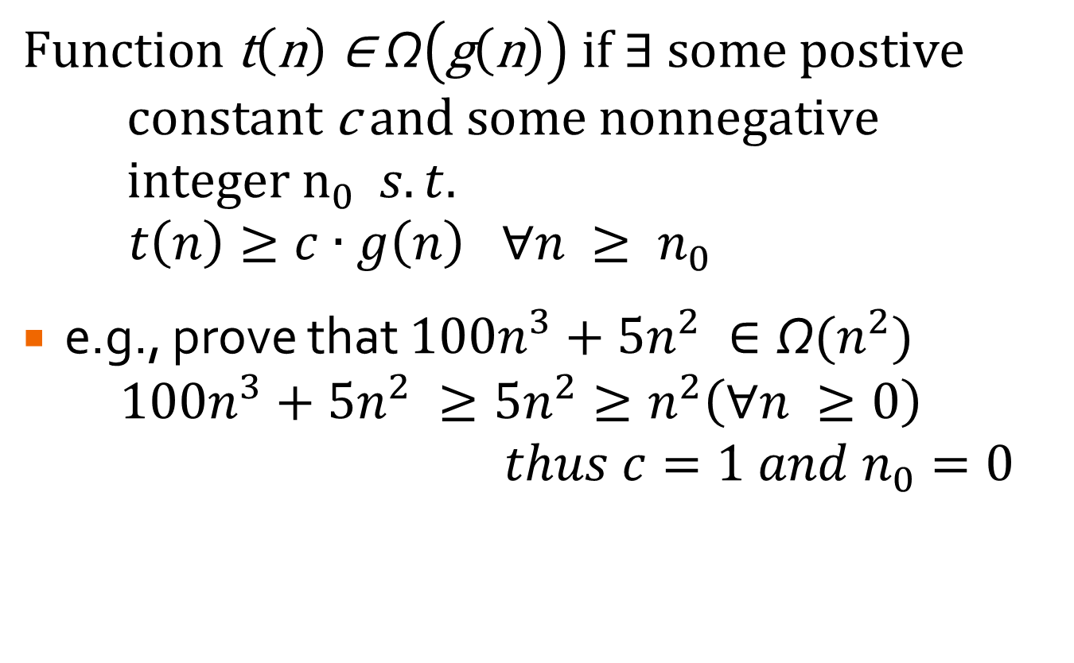
Ω-Notation (formal)
$$\text{Function} \text{t}\left(\text{n}\right) \text{∈} \text{Ω}\left(\text{g}\left(\text{n}\right)\right) \text{if}\text{ ∃ }\text{some} \text{postive} \text{constant} \text{c} \text{and} \text{some} \text{nonnegative} \text{integer} n_{0} s.t.$$
$$t\left(n\right)≥c∙g\left(n\right) ∀n ≥ n_{0}$$
e.g., prove that $100n^{3}+5n^{2} ∈\text{Ω}(n^{2})$
$$100n^{3}+5n^{2} ≥{5n}^{2}≥n^{2}\left(∀n ≥0\right)$$
$$thus c=1 and n_{0}=0$$

Slide 17
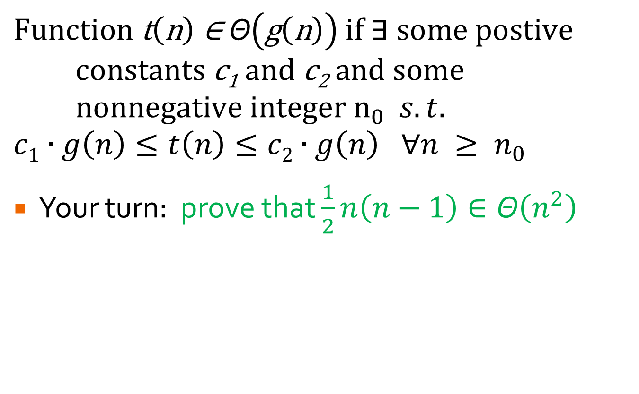
Θ-Notation (formal)
$$\text{Function} \text{t}\left(\text{n}\right) \text{∈} \text{Θ}\left(\text{g}\left(\text{n}\right)\right) \text{if}\text{ ∃ }\text{some} \text{postive} \text{constants} \text{c}\text{1} \text{and} \text{c}\text{2} \text{and} \text{some} \text{nonnegative} \text{integer} n_{0} s.t.$$
$$c1∙g\left(n\right)≤t\left(n\right)≤c2∙g\left(n\right) ∀n ≥ n_{0}$$
Your turn: prove that $\frac{1}{2}n\left(n−1\right)∈\text{Θ}\left(n^{2}\right)$

Slide 18
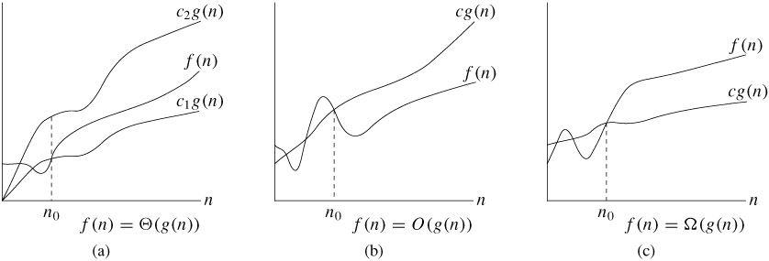
Visually…

Slide 19
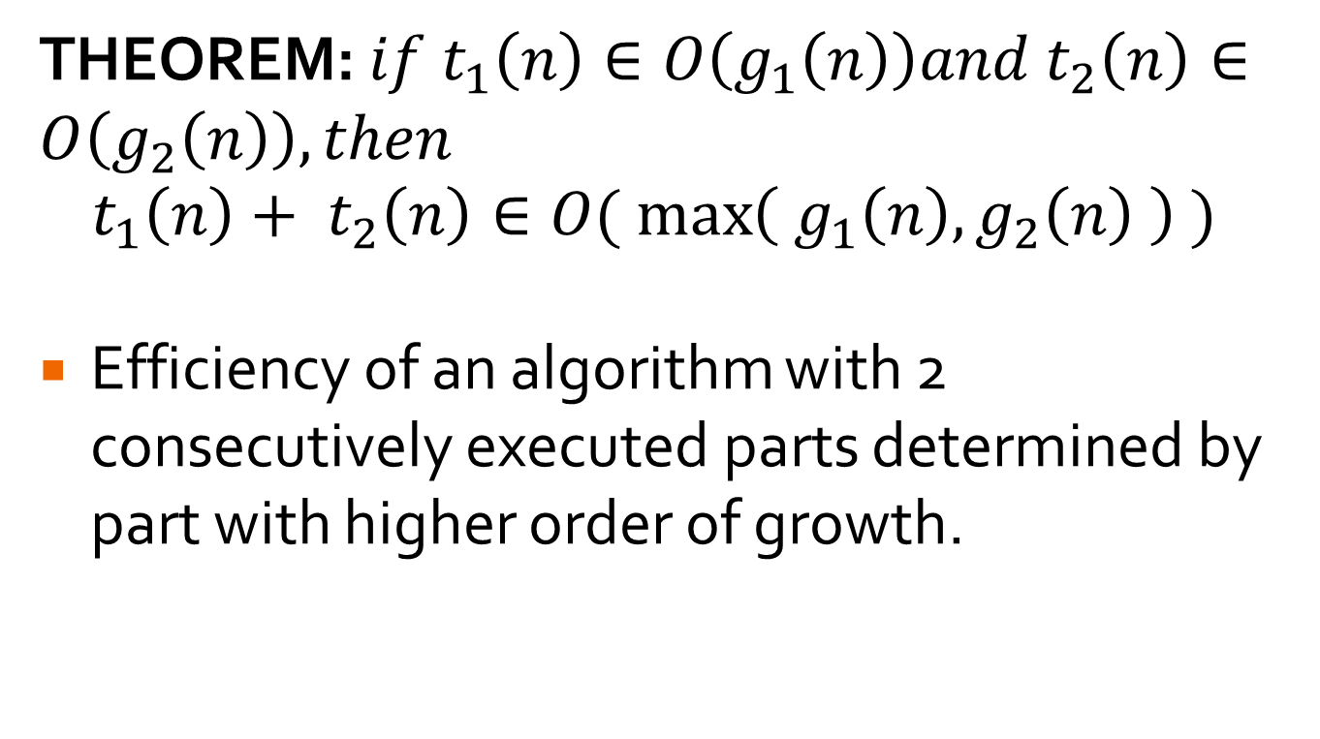
Useful Theorem
THEOREM: $if t_{1}\left(n\right)∈O\left(g_{1}\left(n\right)\right)and t_{2}\left(n\right)∈O\left(g_{2}\left(n\right)\right), then$
$$t_{1}\left(n\right)+ t_{2}\left(n\right)∈O(\max\left({ g}_{1}\left(n\right), g_{2}\left(n\right) \right) )$$
Efficiency of an algorithm with 2 consecutively executed parts determined by part with higher order of growth.

Slide 20

Limit Ratios
Alternative for proving order of growth:
$$\lim_{n→∞}{\frac{t(n)}{g(n)}=\left\{\begin{matrix}0 implies t\left(n\right)has smaller order of growth than g(n) \\ c implies t\left(n\right)has same order of growth as g\left(n\right) \\ ∞ implies t\left(n\right)has larger order of growth than g(n)\end{matrix}\right.}$$
Which bounds are implied by the 3 parts?

Slide 21
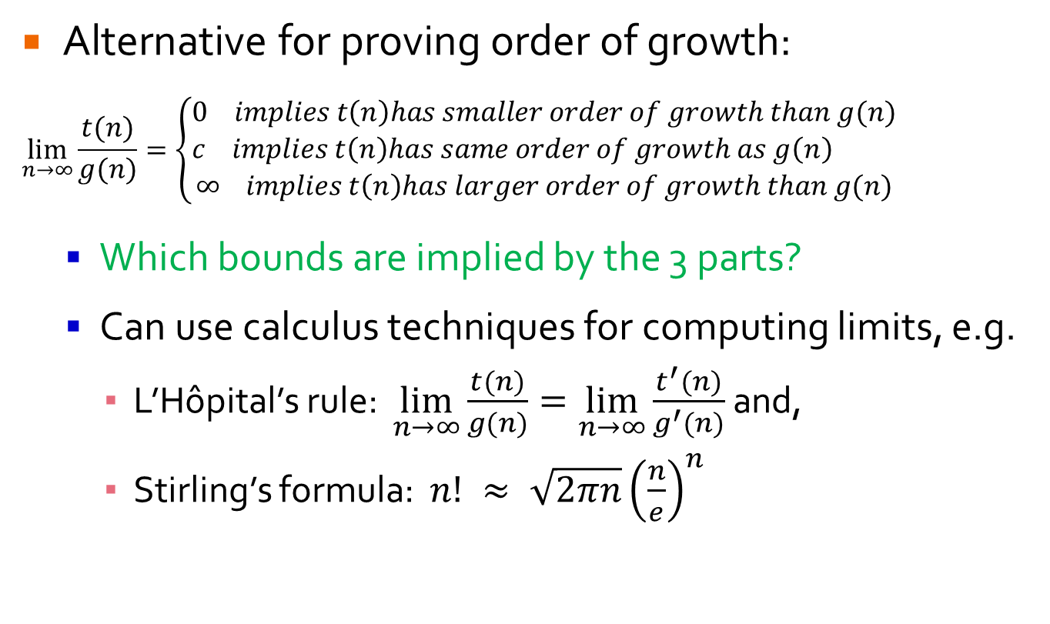
Limit Ratios
Alternative for proving order of growth:
$$\lim_{n→∞}{\frac{t(n)}{g(n)}=\left\{\begin{matrix}0 implies t\left(n\right)has smaller order of growth than g(n) \\ c implies t\left(n\right)has same order of growth as g\left(n\right) \\ ∞ implies t\left(n\right)has larger order of growth than g(n)\end{matrix}\right.}$$
Which bounds are implied by the 3 parts?
Can use calculus techniques for computing limits, e.g.
L’Hôpital’s rule: $\lim_{n→∞}{\frac{t(n)}{g(n)}=\lim_{n→∞}{\frac{t^{′}(n)}{g^{′}(n)} }}$and,
Stirling’s formula: $n! ≈ \sqrt{2πn}{\left(\frac{n}{e}\right)}^{n}$

Slide 22

Limit Ratio Examples
$\lim_{n→∞}{\frac{\frac{1}{2}n(n−1)}{n^{2}}}$
$\lim_{n→∞}{\frac{\log_{2}{n}}{\sqrt{n}}}$
$\lim_{n→∞}{\frac{n!}{2^{n}}}$

Slide 23
Lab
Lab 3
More examples available in textbook

